Slide 1

IS Project Design Presentation
Housecare Connect: A maintenance service locator
148593 – Kariuki, Jamie Nicholas
147163 – Wainaina, Benson Ranji

Slide 2
Introduction
The informal sector experiences challenges in reachability. Service providers have few methods of reaching potential customers, e.g. word of mouth, which are inefficient in spreading information to a large audience.
Customers also are unable to reach these services in a timely manner when needed and are unable to ascertain the competency levels of those they can, leaving room for subpar services.
This project aims to create a web application that will bridge the gap between customers and skilled service providers, allowing those in need of their services to identify and contact one at their convenience.

Slide 3

Functional & Non-functional requirements

Slide 4
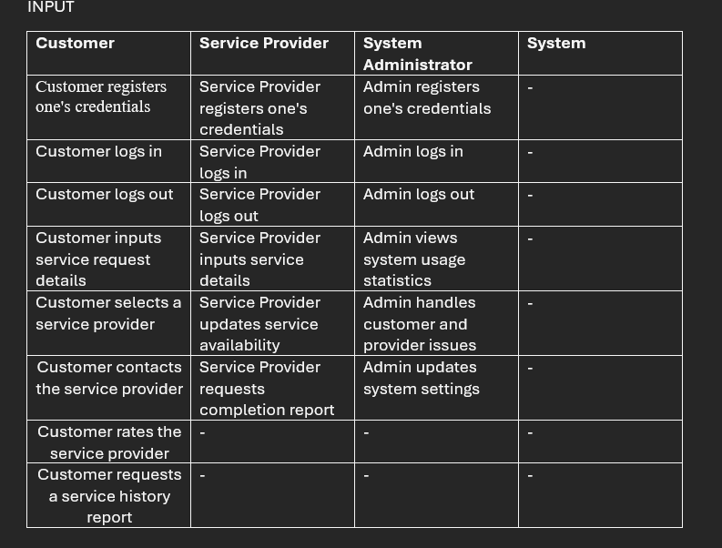
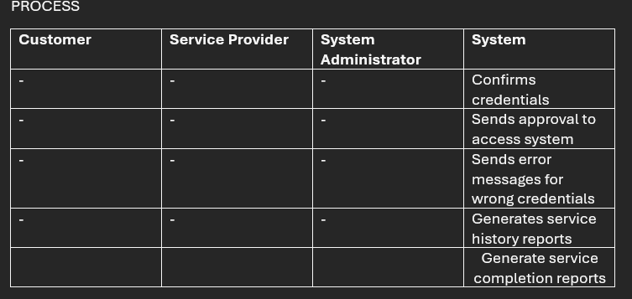

Slide 5
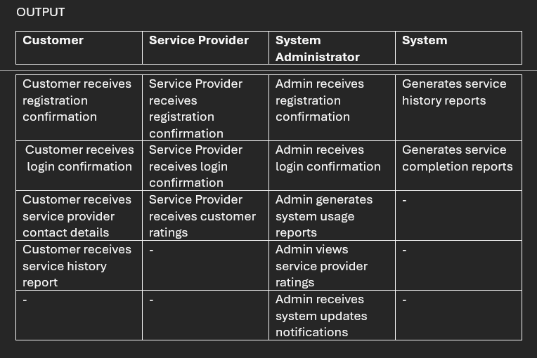
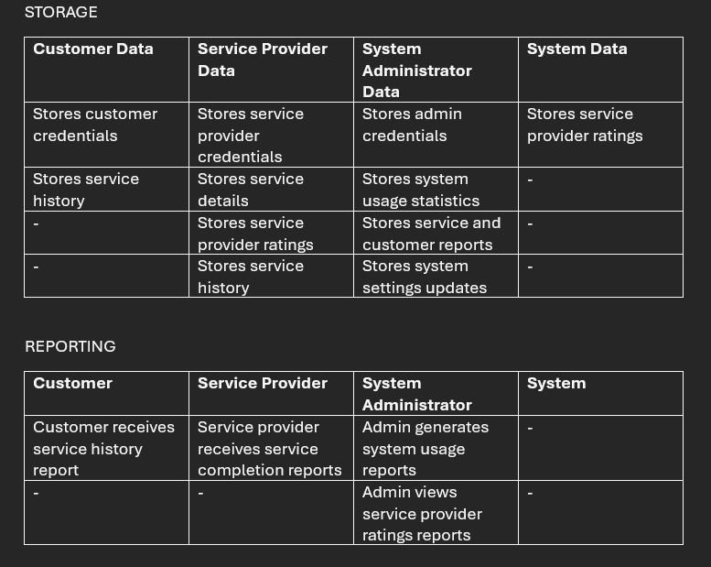

Slide 6

Use case diagram

Slide 7
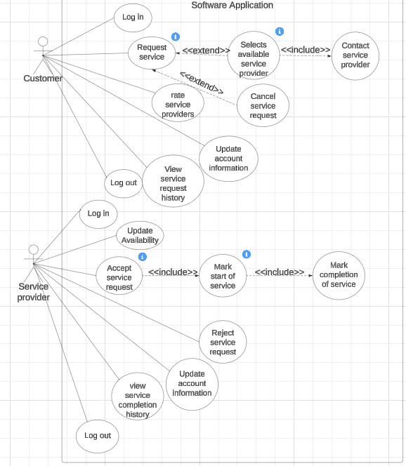

Slide 8
Class diagram

Slide 9
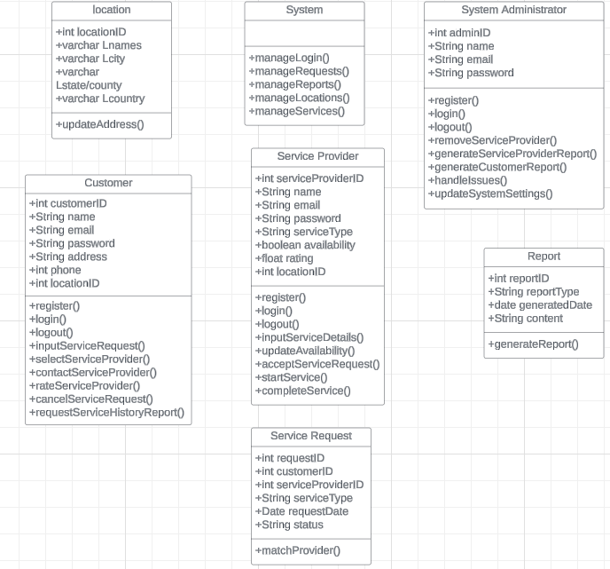

Slide 10

DB SCHema

Slide 11
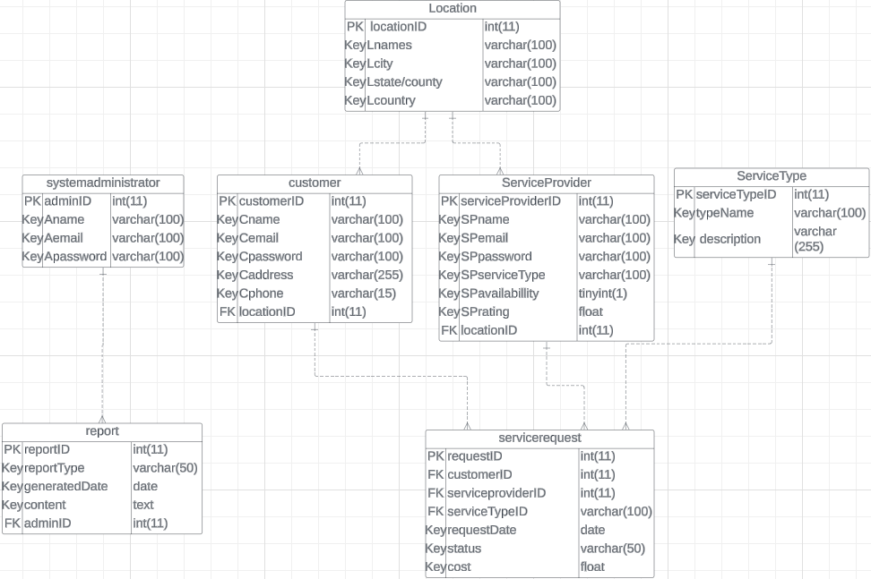

Slide 12

Sequence diagram

Slide 13
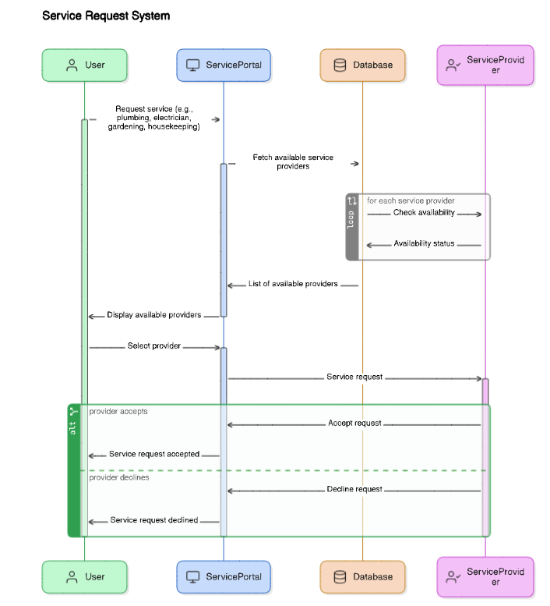

Slide 14

ERD

Slide 15
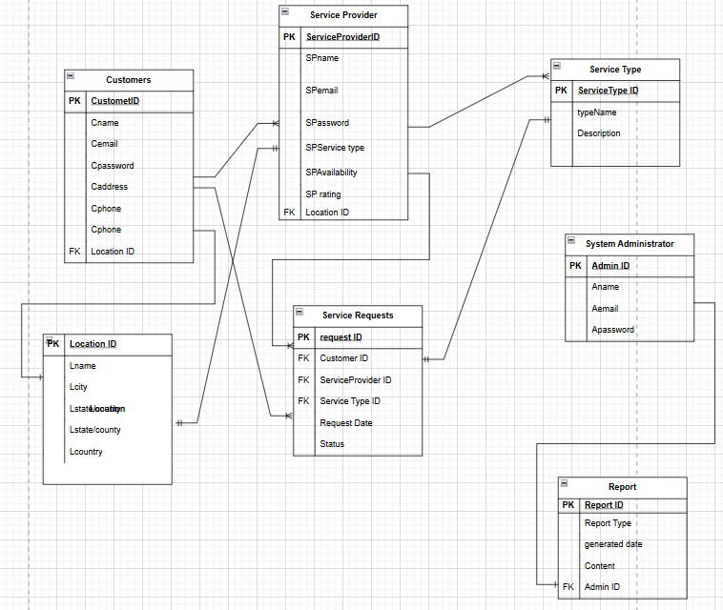

Slide 16
WIREFRAMES

Slide 17
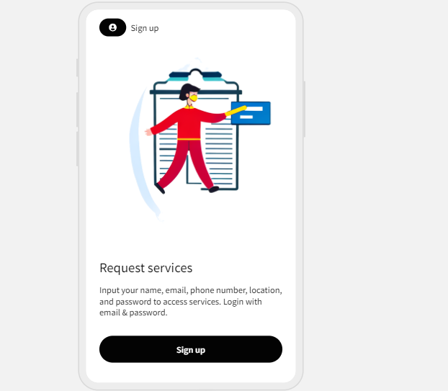
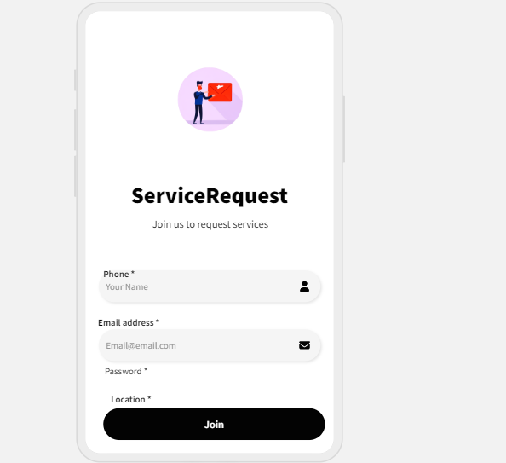

Slide 18
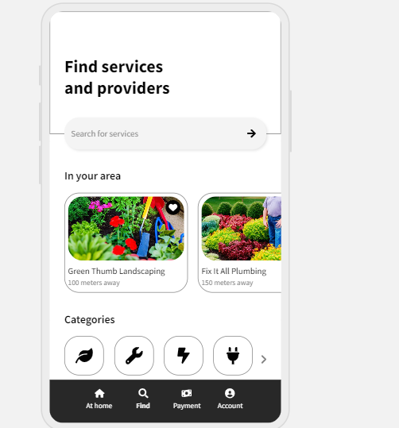
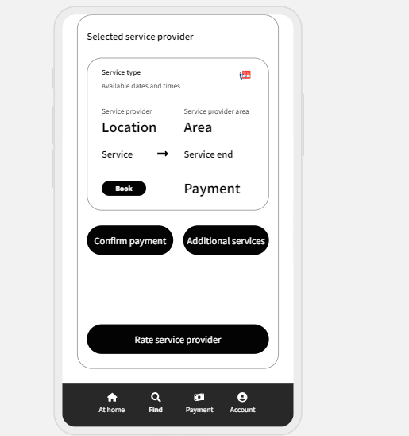

Slide 19
